Slide 1







Files, Directories, Exceptions
Working with the File System and Handling Runtime Exceptions
Programming Fundamentals
SoftUni Team
Technical Trainers
try-catch
Software University
http://softuni.bg

Slide 2
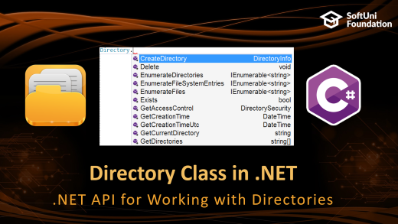
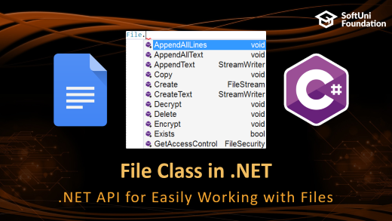
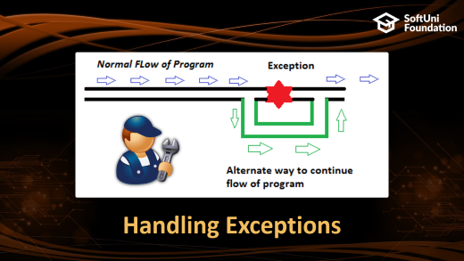
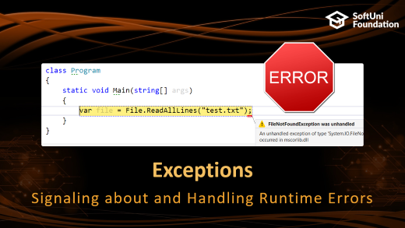
Table of Contents

Slide 3
Have a Question?
sli.do #fund-softuni

Slide 4
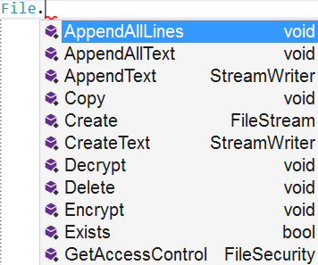

File Class in .NET
.NET API for Easily Working with Files

Slide 5
Reading Text Files
File.ReadAllText() → string – reads a text file at once
File.ReadAllLines() → string[] – reads a text file's lines
using System.IO;
…
string text = File.ReadAllText("file.txt");
using System.IO;
…
string[] lines = File.ReadAllLines("file.txt");

Slide 6
Writing Text Files
Writing a string to a text file:
Writing a sequence of strings to a text file, at separate lines:
Appending additional text to an existing file:
File.WriteAllText("output.txt", "Files are fun :)");
string[] names = {"peter", "irina", "george", "maria"};
File.WriteAllLines("output.txt", names);
File.AppendAllText("output.txt", "\nMore text\n");

Slide 7
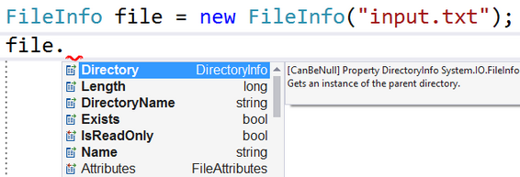
Inspecting Files
Use FileInfo to get information about a file:
var info = new FileInfo("output.txt");
Console.WriteLine("File size: {0} bytes", info.Length);
Console.WriteLine("Created at: {0}", info.CreationTime);
Console.WriteLine("Path + name: {0}", info.FullName);
Console.WriteLine("File extension: {0}", info.Extension);

Slide 8
Problem: Odd Lines
Write a program to read a text file lines.txt and extract its odd lines (starting from 0) in a text file odd-lines.txt
File.ReadAllLines(…) method opens a text file,
reads all lines of the file, and then closes the file.
This method attempts to automatically detect the encoding
of a file based on the presence of byte order marks.
Encoding formats UTF-8 and UTF-32 (both big-endian and
little-endian) can be detected.
reads all lines of the file, and then closes the file.
of a file based on the presence of byte order marks.
little-endian) can be detected.

Slide 9
Solution: Odd Lines
string[] lines = File.ReadAllLines("lines.txt");
File.Delete("odd-lines.txt");
for (int i = 1; i < lines.Length; i += 2)
File.AppendAllText("odd-lines.txt",
lines[i] + Environment.NewLine);
A better solution:
string[] lines = File.ReadAllLines("lines.txt");
var oddLines = lines.Where((line, index) => index % 2 == 1);
File.WriteAllLines("odd-lines.txt", oddLines);

Slide 10
Problem: Insert Line Numbers
Read a text file input.txt line by line
Insert line numbers in front of each line (start by 1)
Write the result in a text file output.txt
first line
second line
third line
fourth line
fifth line
1. first line
2. second line
3. third line
4. fourth line
5. fifth line

Slide 11
Solution: Line Numbers
string[] lines = File.ReadAllLines("input.txt");
var numberedLines = lines.Select(
(line, index) => $"{index+1}. {line}");
File.WriteAllLines("output.txt", numberedLines);

Slide 12
Problem: Word Count
Read a list of words from words.txt and find how many times each word occurs (as case-insensitive) in a text file text.txt
Write the results in results.txt
Sort the words by frequency in descending order
-I was quick to judge him, but it wasn't his fault.
-Is this some kind of joke?! Is it?
-Quick, hide here…It is safer.
text.txt
is -> 3
quick -> 2
fault -> 1
quick is fault
words.txt
results.txt

Slide 13
Solution: Word Count
string[] words =
File.ReadAllText("words.txt").ToLower().Split();
string[] text = File.ReadAllText("input.txt").ToLower()
.Split(new char[] {'\n','\r',' ', '.', ',', '!', '?', '-'},
StringSplitOptions.RemoveEmptyEntries);
var wordCount = new Dictionary<string, int>();
foreach (string word in words)
wordCount[word] = 0;
foreach (string word in text)
if (wordCount.ContainsKey(word))
wordCount[word]++;
// Write the output (sorted) to a text file "results.txt"

Slide 14
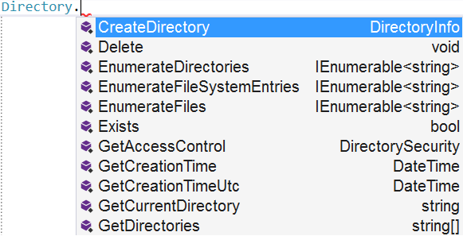
Directory Class in .NET
.NET API for Working with Directories

Slide 15
Basic Directory Operations
Creating a directory (with all its subdirectories at the specified path), unless they already exists:
Deleting a directory (with its contents):
Moving a file or directory to a new location:
Directory.CreateDirectory("TestFolder");
Directory.Delete("TestFolder", true);
Directory.Move("Test", "New Folder");

Slide 16
Listing Directory Contents
GetFiles() – returns the names of files (including their paths) in the specified directory
GetDirectories() – returns the names of subdirectories (including their paths) in the specified directory
string[] filesInDir =
Directory.GetFiles("TestFolder");
string[] subDirs =
Directory.GetDirectories("TestFolder");

Slide 17
Problem: Calculate Folder Size
You are given a folder named TestFolder
Calculate the size of all files in the folder (without subfolders)
Print the result in a file output.txt" in Megabytes
output.txt
5.16173839569092

Slide 18
Solution: Calculate Folder Size
string[] files = Directory.GetFiles("TestFolder");
double sum = 0;
foreach (string file in files)
{
FileInfo fileInfo = new FileInfo(file);
sum += fileInfo.Length;
}
sum = sum / 1024 / 1024;
File.WriteAllText("оutput.txt", sum.ToString());

Slide 19
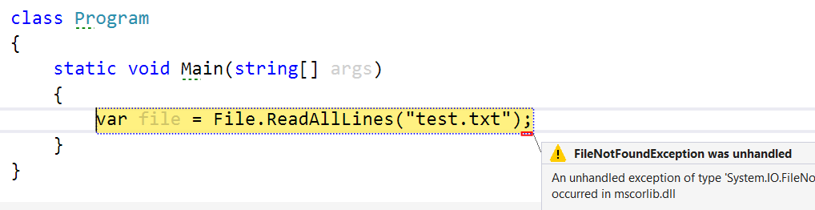
Exceptions
Signaling about and Handling Runtime Errors

Slide 20
What are Exceptions?
Exceptions are a powerful mechanism for centralized handling of errors and unusual events
Raised at runtime, when a problem occurs
Can be caught and handled

Slide 21
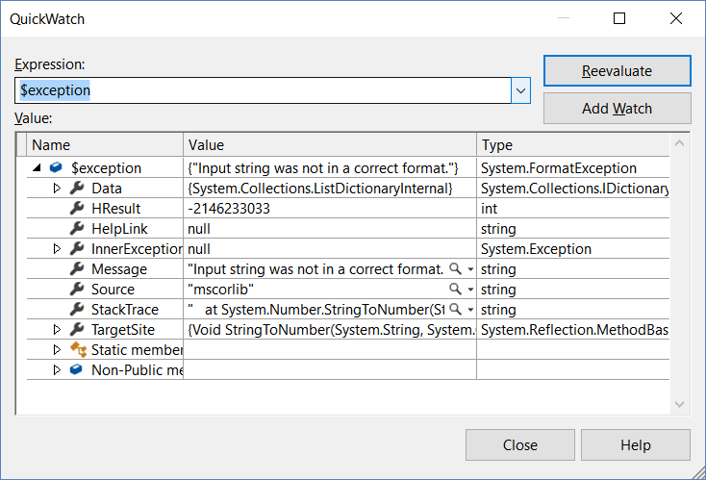
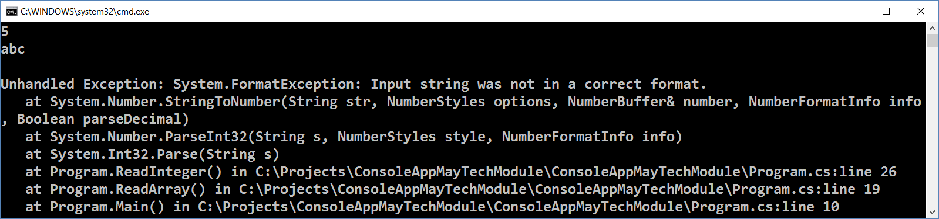
The System.Exception Class
The System.Exception class is base for all exceptions in .NET
Holds information about the problem
Message – problem description (text)
StackTrace –snapshot of the stack

Slide 22
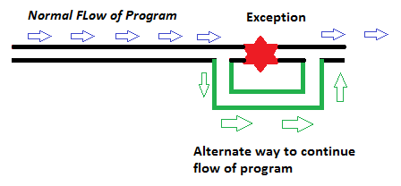

Handling Exceptions

Slide 23
The try-catch Statement
Catching exceptions:
try
{
// Do some work that can cause an exception
}
catch
{
// This block will execute if any type of exception occurs
}

Slide 24
The try-catch Statement (2)
Catching a certain exception types only:
try
{
// Do some work that can cause an exception
}
catch (FormatException formatException)
{
// This block will execute only if format exception occurs
}

Slide 25
The try-finally Statement
Ensures execution of given block in all cases
When exception is raised or not in the try block
Used for execution of cleaning-up code, e.g. releasing resources
try
{
// Do some work that can cause an exception
}
finally
{
// This block will always execute
}

Slide 26
The try-catch-finally Statement
try
{
// Do some work that can cause an exception
}
catch(FileNotFoundException fileNotFoundEx)
{
// This block will be executed only if
// "file not found" exception occurs
}
finally
{
// This block will always execute
}

Slide 27

Summary
Use the File class to work with files
Create / modify / read / write / delete files
Use the Directory class to work with directories
Create / delete directories / list files / folders
Exceptions provide error handling mechanism
Hold information about a runtime error
Can be caught and handled
try-catch

Slide 28







Programming Fundamentals – Objects & Classes
https://softuni.bg/courses/programming-fundamentals

Slide 29
License
This course (slides, examples, demos, videos, homework, etc.) is licensed under the "Creative Commons Attribution-NonCommercial-ShareAlike 4.0 International" license

Slide 30





Trainings @ Software University (SoftUni)
Software University – High-Quality Education, Profession and Job for Software Developers
softuni.bg
Software University Foundation
http://softuni.foundation/
Software University @ Facebook
facebook.com/SoftwareUniversity
Software University Forums
forum.softuni.bg

